Slide 1
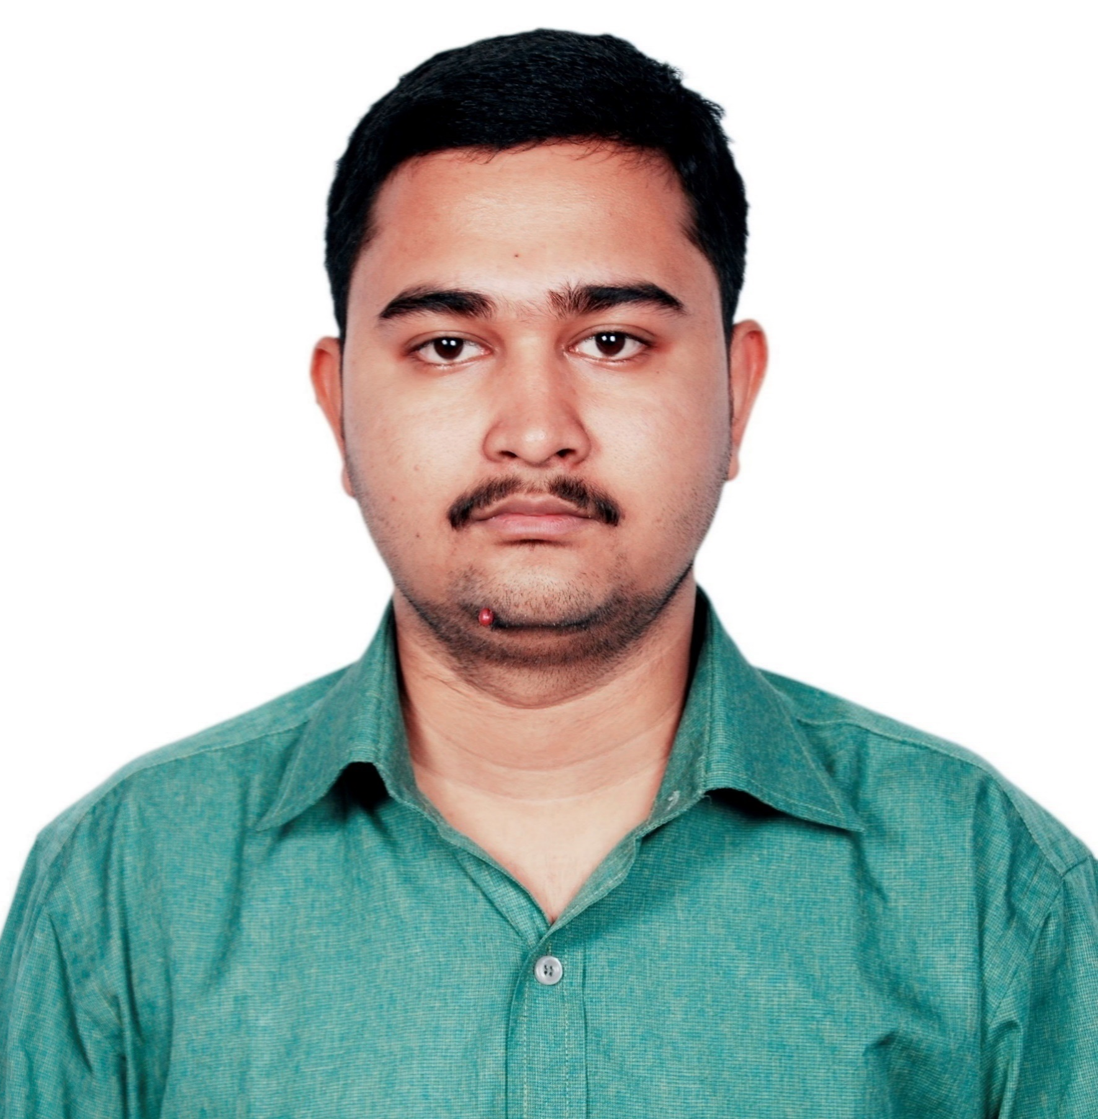



Tamoghna Roy
Analyst/Software Engineer
Bachelor of Technology
Computer Science : 2018 - 2022
Skills
Java 8 /J2EE | Java Basics, OOPS, Generics, Collections, Arrays, Loops, Lambda Exp, Stream API Junit, Mockito, Servlets
Spring core | IOC & Dependency Injection, Autowired
Spring REST | REST controllers, Implementation of GET, POST, PUT & DELETE, Bean Validation & Exception Handling, Testing Services, Controller & Repository layer
Spring Data JPA | Implement DAO layer using spring Data repositories, Transaction Management
Spring Boot Microservices | Spring Boot Starters, annotations,Swagger API documents
Spring Cloud | Eureka, Eureka Client, Netflix Hystrix, Netflix Zuul & API Gateway
React | Components, Hooks, Event handling, Redux, Reducers.
Database | MongoDB No Sql Basics, My SQL RDBMS PostgreSql
UI Tech | HTML 5 & CSS 3,JavaScript, ES6 & TypeScript
Tools | Git, Postman, Maven, IDE
Devops | CI/CD, Build Pipelines, notifications, quality gate understanding
Add On skills | Communications, Team management. Peer learning
Mumbai
TAMOGHNA.ROY@CAPGEMINI.COM
+917719341441
A4
Full Stack Developer
Hands on experience in creating microservices with Springboot, Spring Security, Spring Cloud API Gateway, Eureka server,load balancing
Proficient in creating Single page Web Application in React with Authentication.
Proficient React developer with working knowledge on ReactJS(Hooks).
Hands on experience in implementing NodeJs & spring boot
Experience in swagger and in unit testing using Junit, Mockito
Online Railway Reservation System
Completed end to end case study of Online Railway Reservation System. Application using microservices approach and communication is done with Rest template along with JWT authentication and, responsive UI CSS, HTML, and React. Database used is MongoDb Atlas.
Check out my work on GitHub & Video Profile

